Slide 1
POPULATION PYRAMID

Slide 2
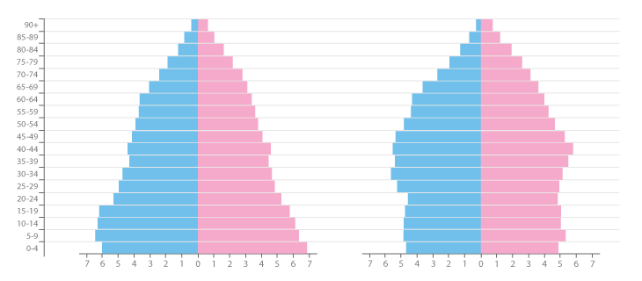
Population Pyramid
Also known as an Age & Sex Pyramid.
A Population Pyramid is a pair of back-to-back Histograms (for each gender) that displays the distribution of a population in all age groups and in both genders.
The X-axis is used to plot population numbers and the Y-axis lists all age groups.
Population Pyramids are ideal for detecting changes or differences in population patterns.
Multiple Population Pyramids can be used to compare patterns across nations or selected population groups.

Slide 3
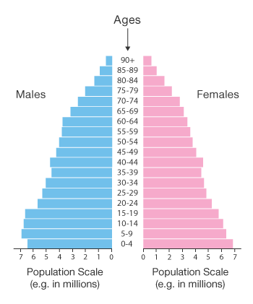
SHAPE
The shape of a Population Pyramid can be used to interpret a population.
For example, a pyramid with a very wide base and a narrow top section suggests a population with both high fertility and death rates.
Whereas, a pyramid with a wider top half and a narrower base would suggest an ageing population with low fertility rates.

Slide 4
PREDICTIONS
Population Pyramids can also be used to speculate a population’s future development.
An ageing population that is not reproducing would eventually run into issues such as having enough offspring to care for the elderly.
Other theories such as the “Youth Bulge” state that when there’s a wide bulge around the 16-30 age range, particularly in males, this leads to social unrest, war and terrorism.

Slide 5
Reference
https://datavizcatalogue.com/methods/population_pyramid.html

Slide 6
THANK YOU

